Slide 1
The Limits to Growth: Sustainability and the Circular Economy
Lecture 09: Technology
Prof. Dr. Benjamin Leiding
M.Sc. Anant Sujatanagarjuna

Slide 2
License
This work is licensed under a Creative Commons Attribution-ShareAlike 4.0 International License. To view a copy of this license, please refer to https://creativecommons.org/licenses/by-sa/4.0/ .
Updated versions of these slides will be available in our Github repository.

Slide 3
News/Updates

Slide 4
Bonus Task
Submissions
1 submission → unfortunately no video

Slide 5
Introduction

Slide 6
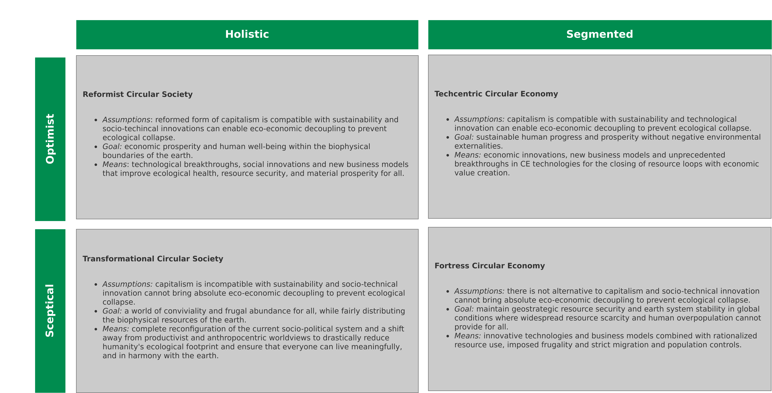
Introduction
CE/CS and Technology
Image recreated from: M. C. Friant, R. Salomone, W. J. V. Vermeulen (2020) – A Typology of Circular Economy Discourses: Navigating the Diverse Visions of a Contested Paradigm – Link

Slide 7
Carbon Capture and Storage

Slide 8
Carbon Capture and Storage
Introduction
Too much CO2? → Lets put it “somewhere”

Slide 9
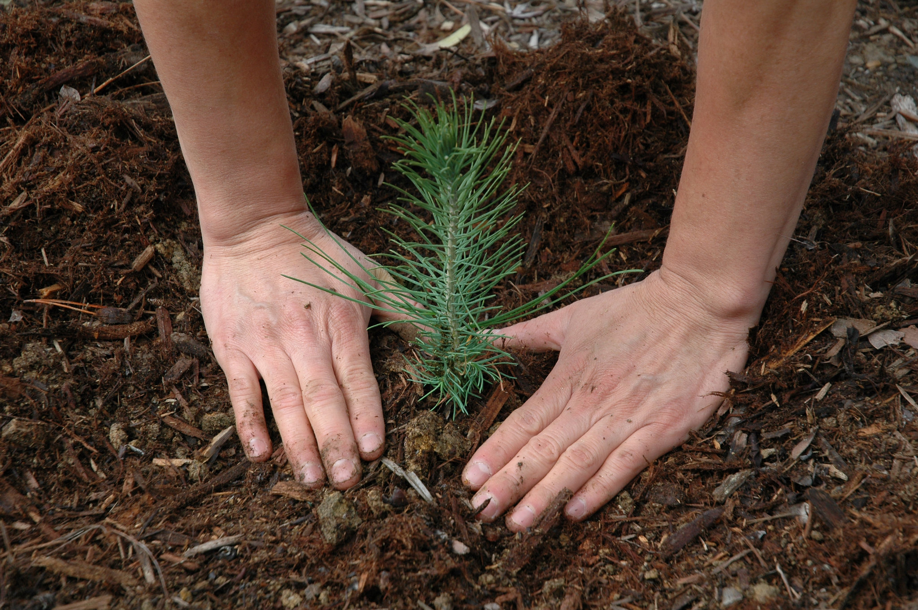
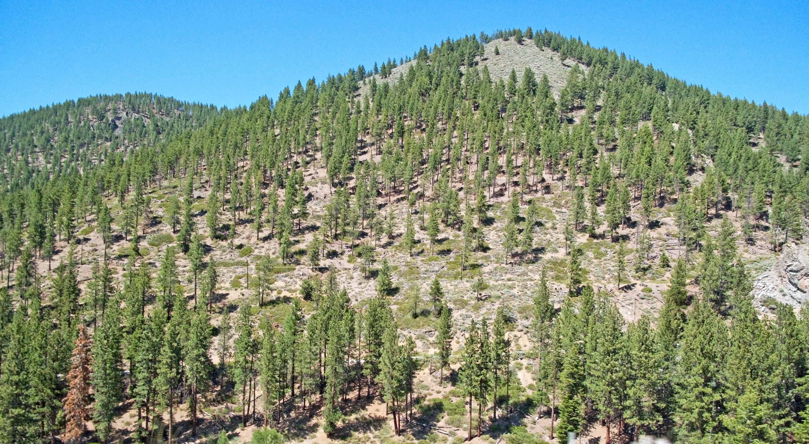
Carbon Capture and Storage
Reforestation
1. Pacific Southwest Forest Service, USDA – https://www.flickr.com/photos/usfsregion5/3598029211 – CC BY 2.0
2. Downtowngal – https://upload.wikimedia.org/wikipedia/commons/3/30/Reforestation%2C_Lake_Tahoe_area.jpg – CC BY-SA 3.0

Slide 10
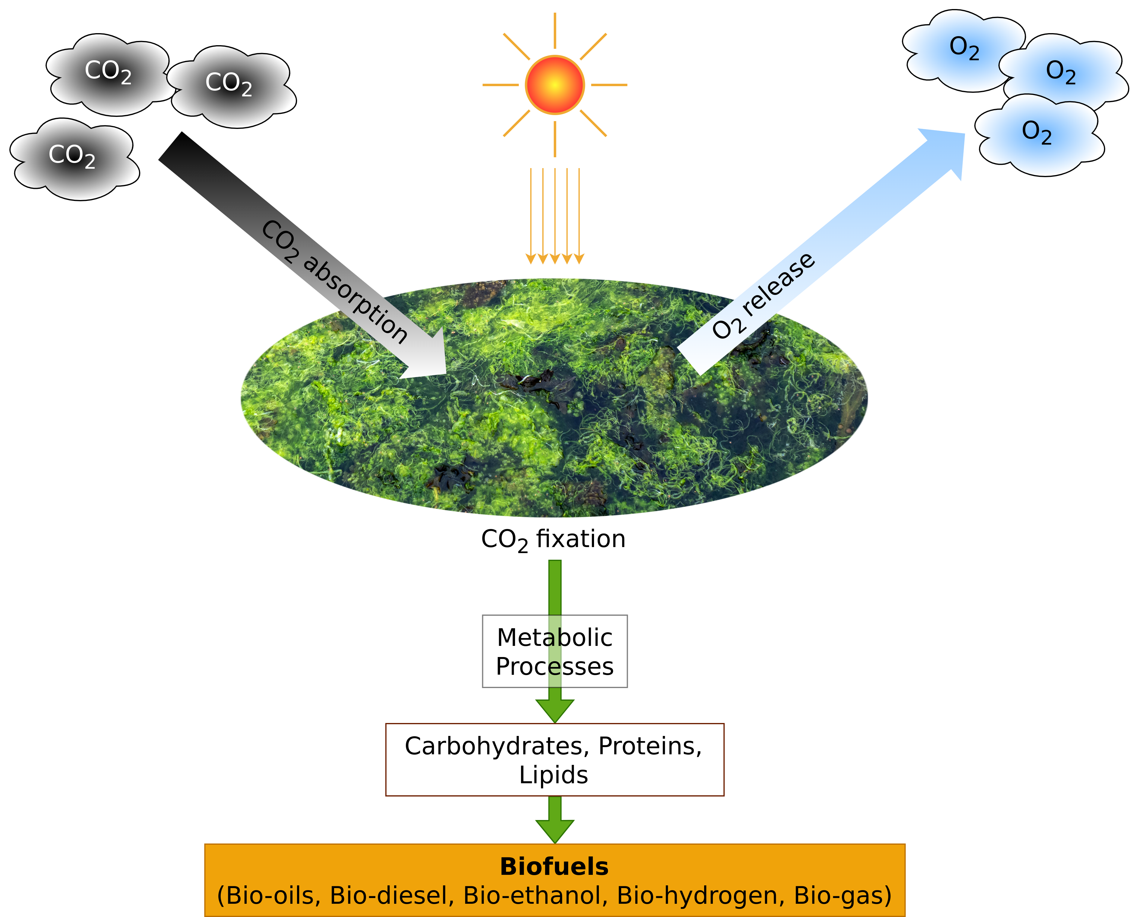
Carbon Capture and Storage
Biological Carbon Capture
Image adapted from: K.K. Jaiswal, S. Dutta, I. Banerjee, C.B. Pohrmen, V. Kumar (2021) – Photosynthetic microalgae–based carbon sequestration and generation of biomass in biorefinery approach for renewable biofuels for a cleaner environment – Link.

Slide 11
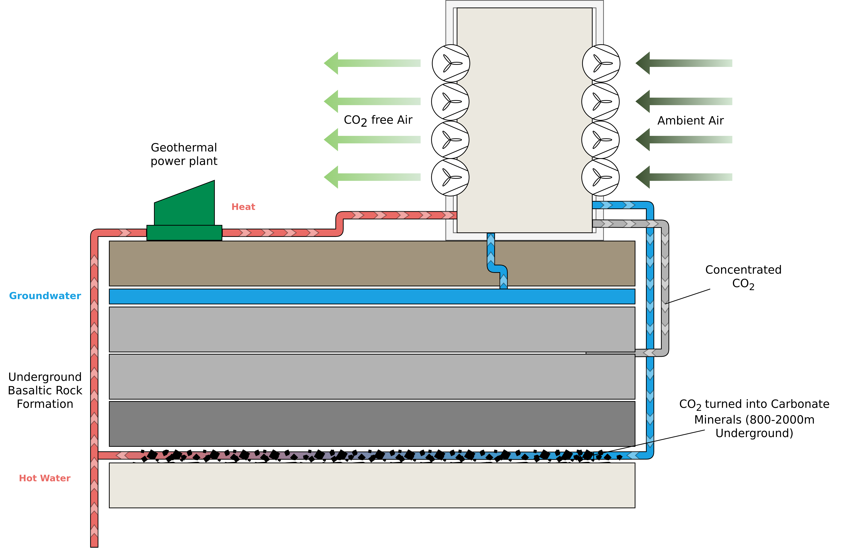
Carbon Capture and Storage
Carbon Mineralisation
Image adapted from: Climeworks (2022) – https://climeworks.com/co2-removal

Slide 12
Alternative Sources of energy

Slide 13
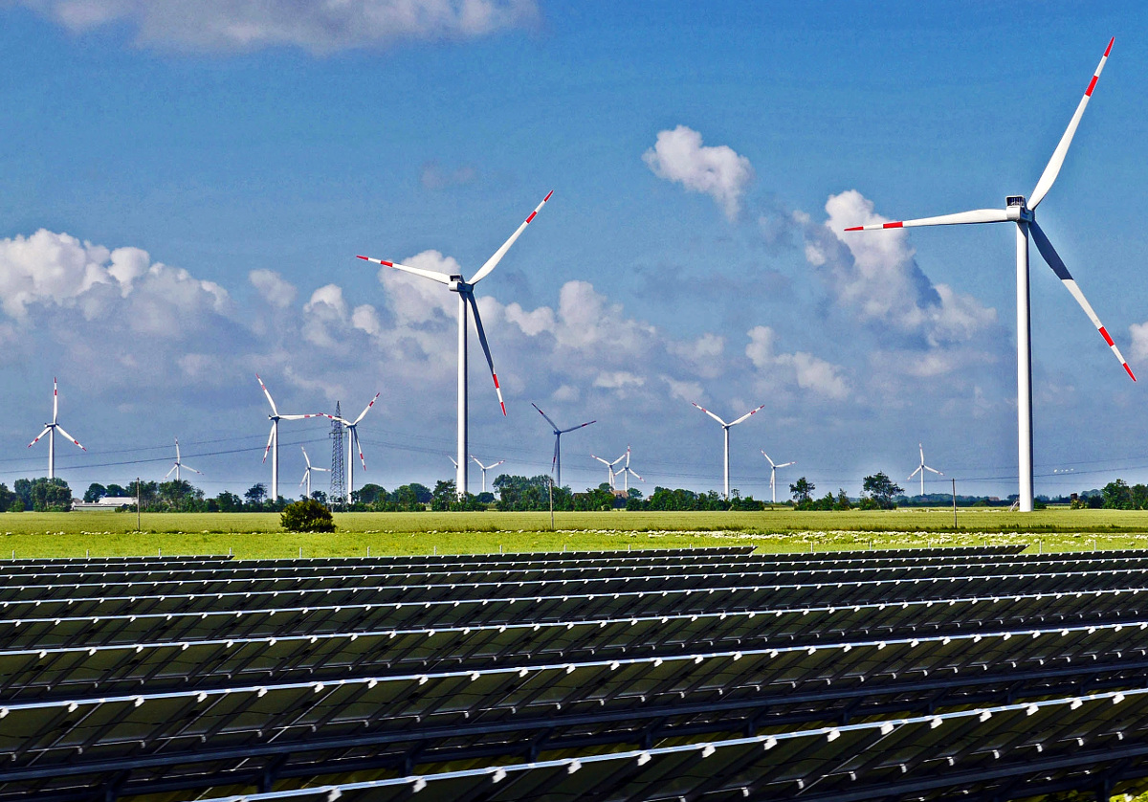
Alternative Sources of Energy
Wind and Solar Farms
hpgruesen – https://upload.wikimedia.org/wikipedia/commons/3/32/Renewable_energy_park.jpg – CC0

Slide 14
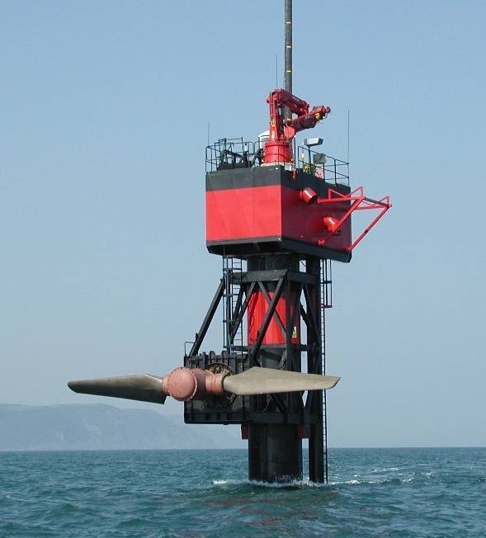
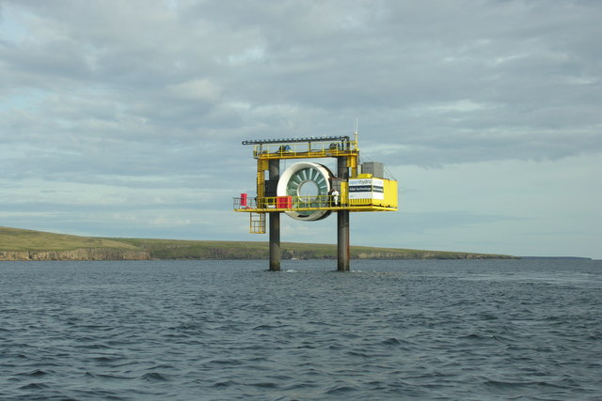
Alternative Sources of Energy
Tidal Power
1. Fundy – https://upload.wikimedia.org/wikipedia/commons/2/25/Seaflow_raised_16_jun_03.jpg – CC BY-SA 3.0
2. George Brown – https://upload.wikimedia.org/wikipedia/commons/d/d8/Eday_Tidal_Generator%2C_Fall_of_Warness_-_geograph.org.uk_-_1884742.jpg – CC BY-SA 2.0

Slide 15
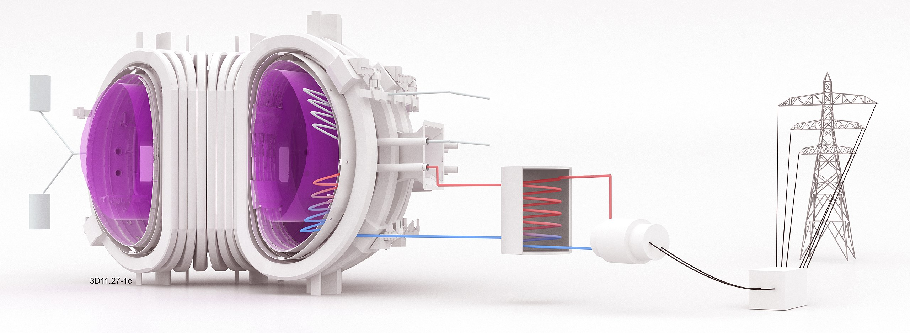
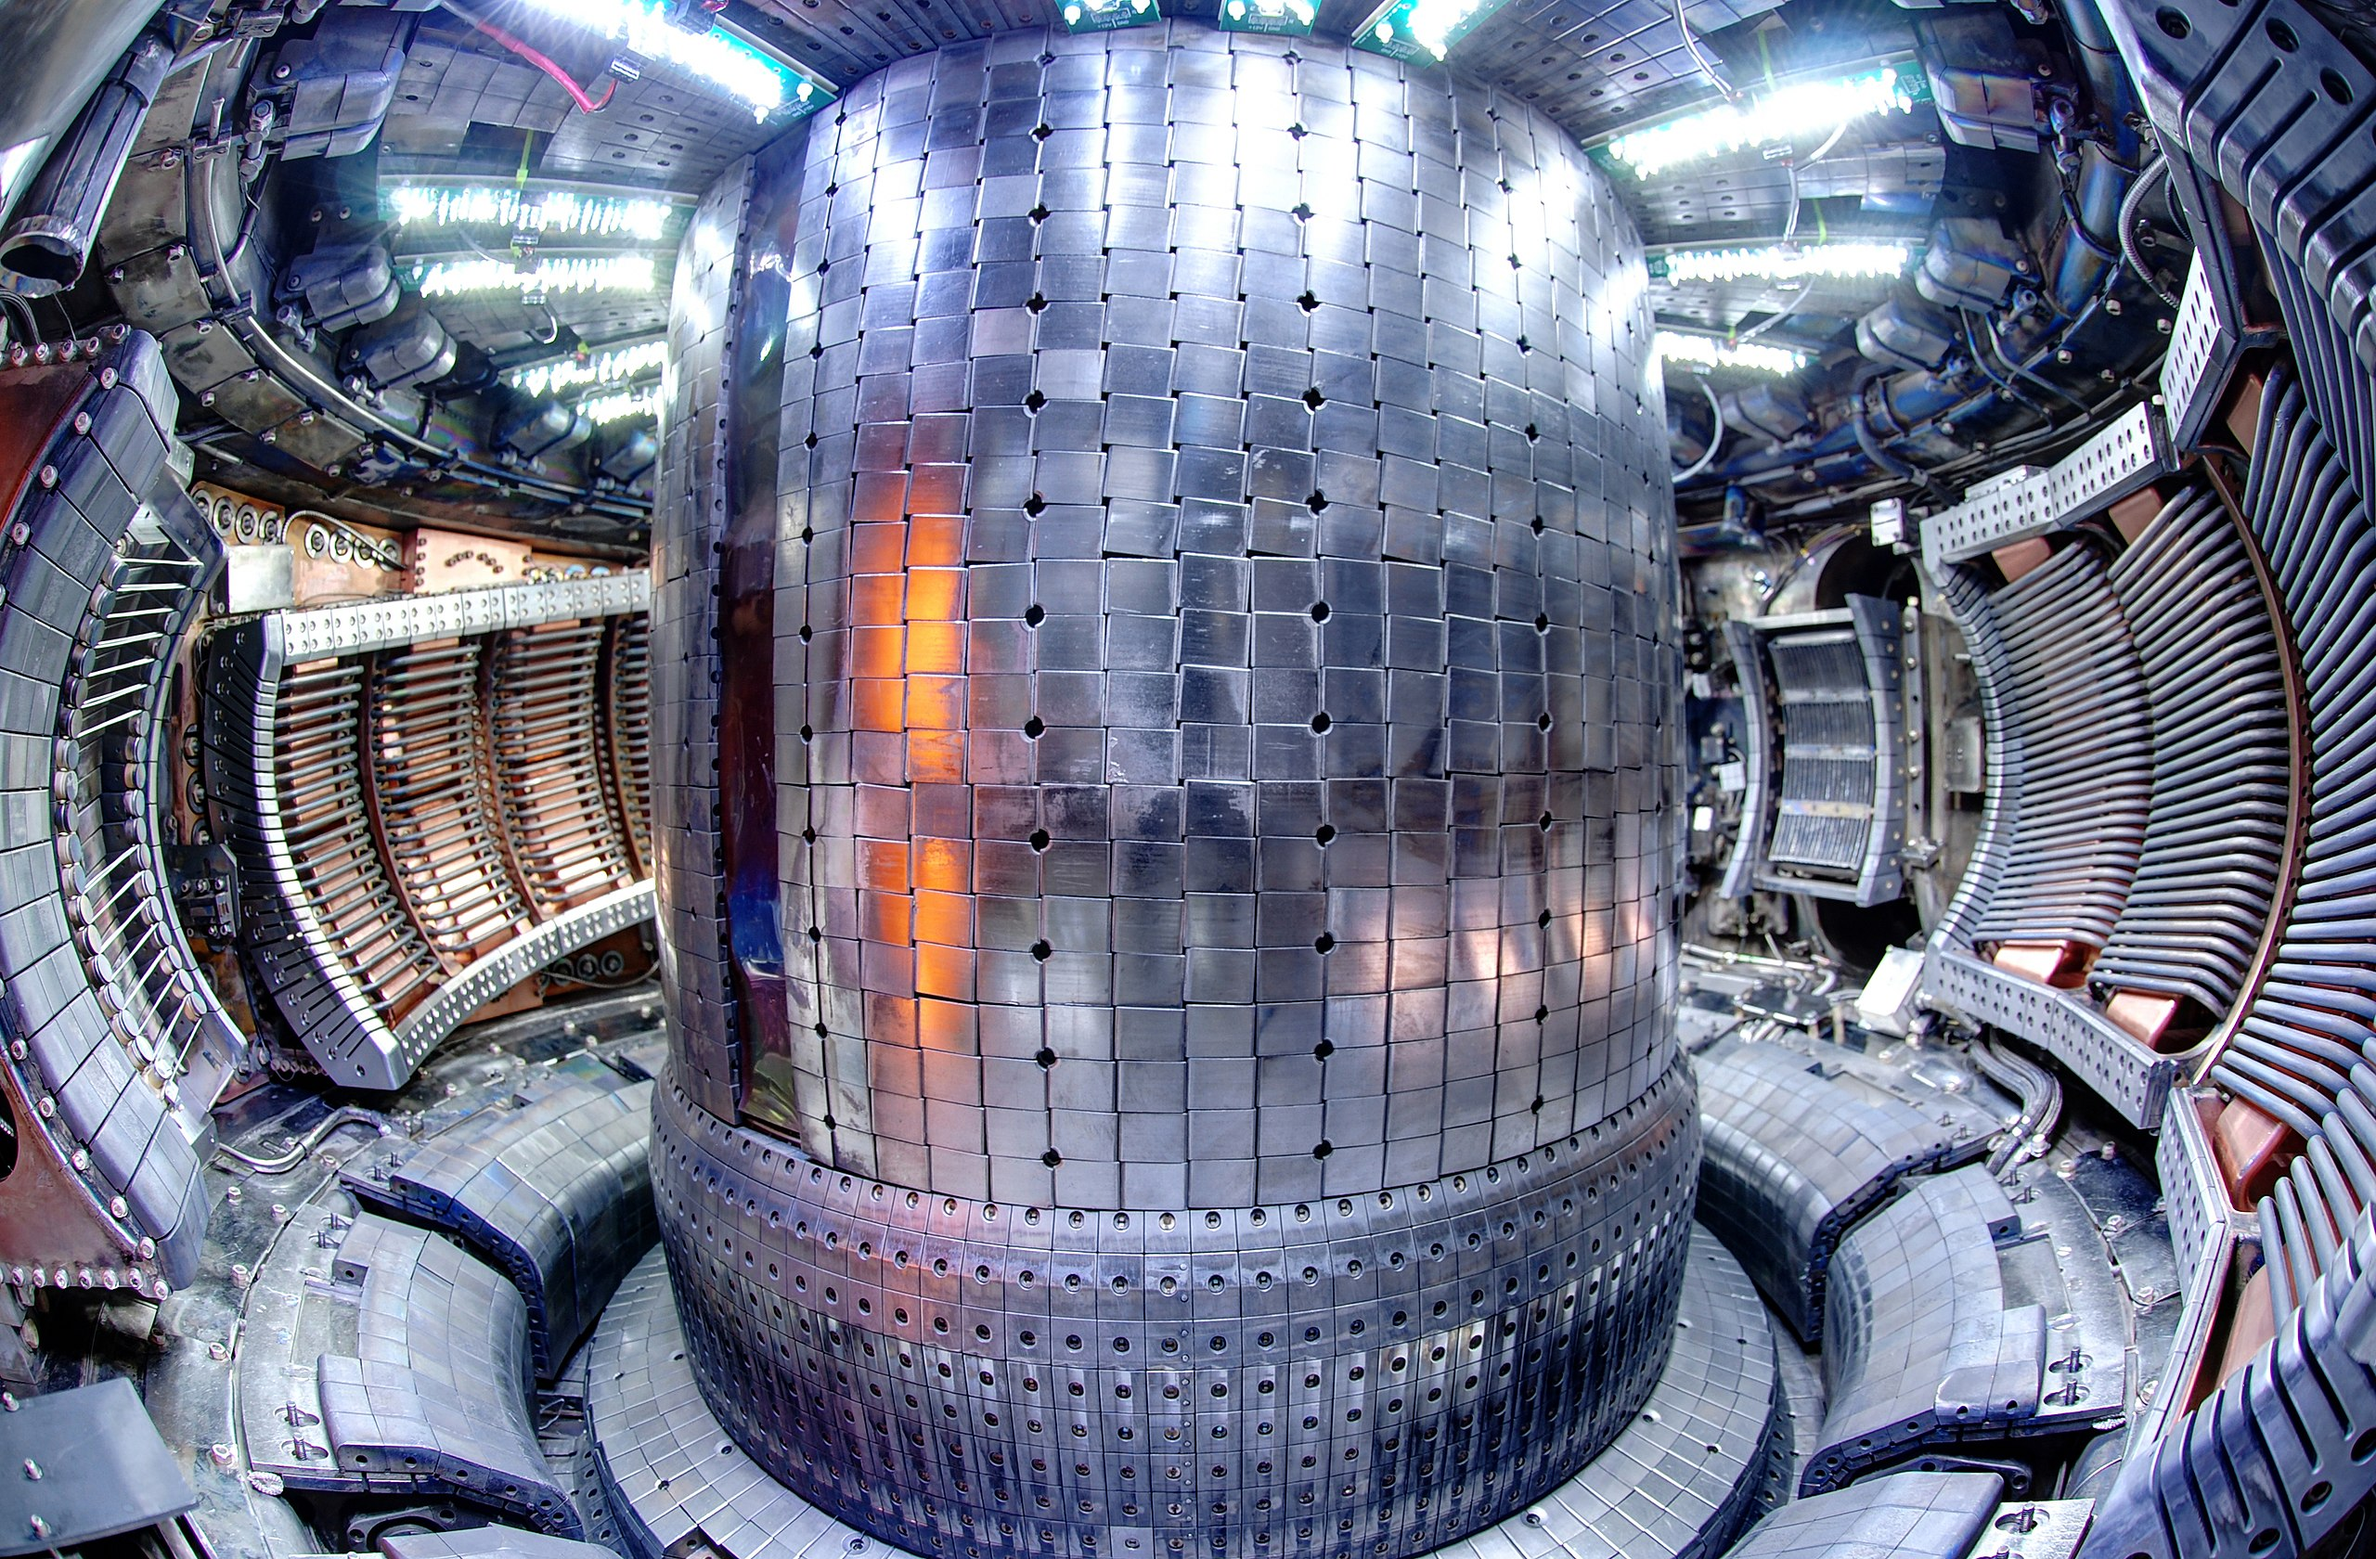
Alternative Sources of Energy
Fusion Power
1. EUROfusion – https://upload.wikimedia.org/wikipedia/commons/e/e9/EUROfusion_schematic_diagram_of_fusion_power_plant.jpg – CC BY-SA 4.0
2. Robert Mumgaard – https://upload.wikimedia.org/wikipedia/commons/8/89/Alcator_C-Mod_Fisheye_from_Fport.jpg –CC BY-SA 3.0

Slide 16
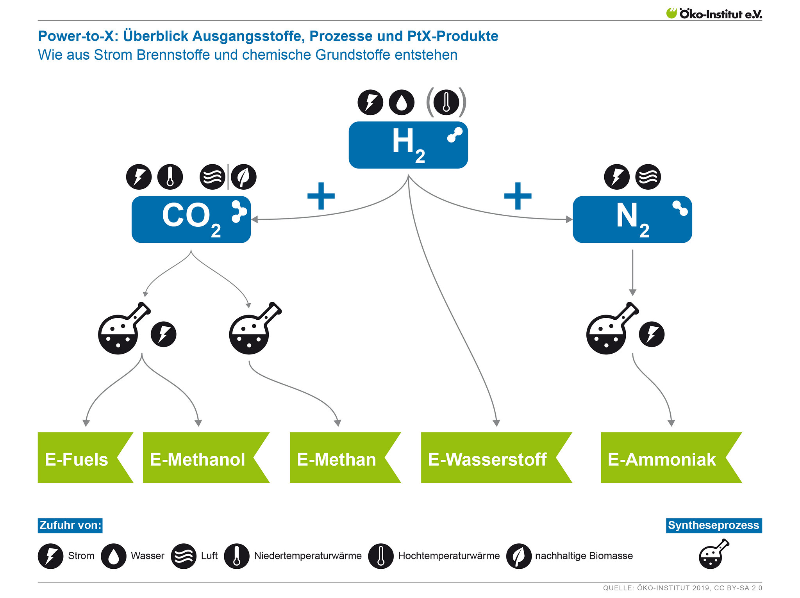
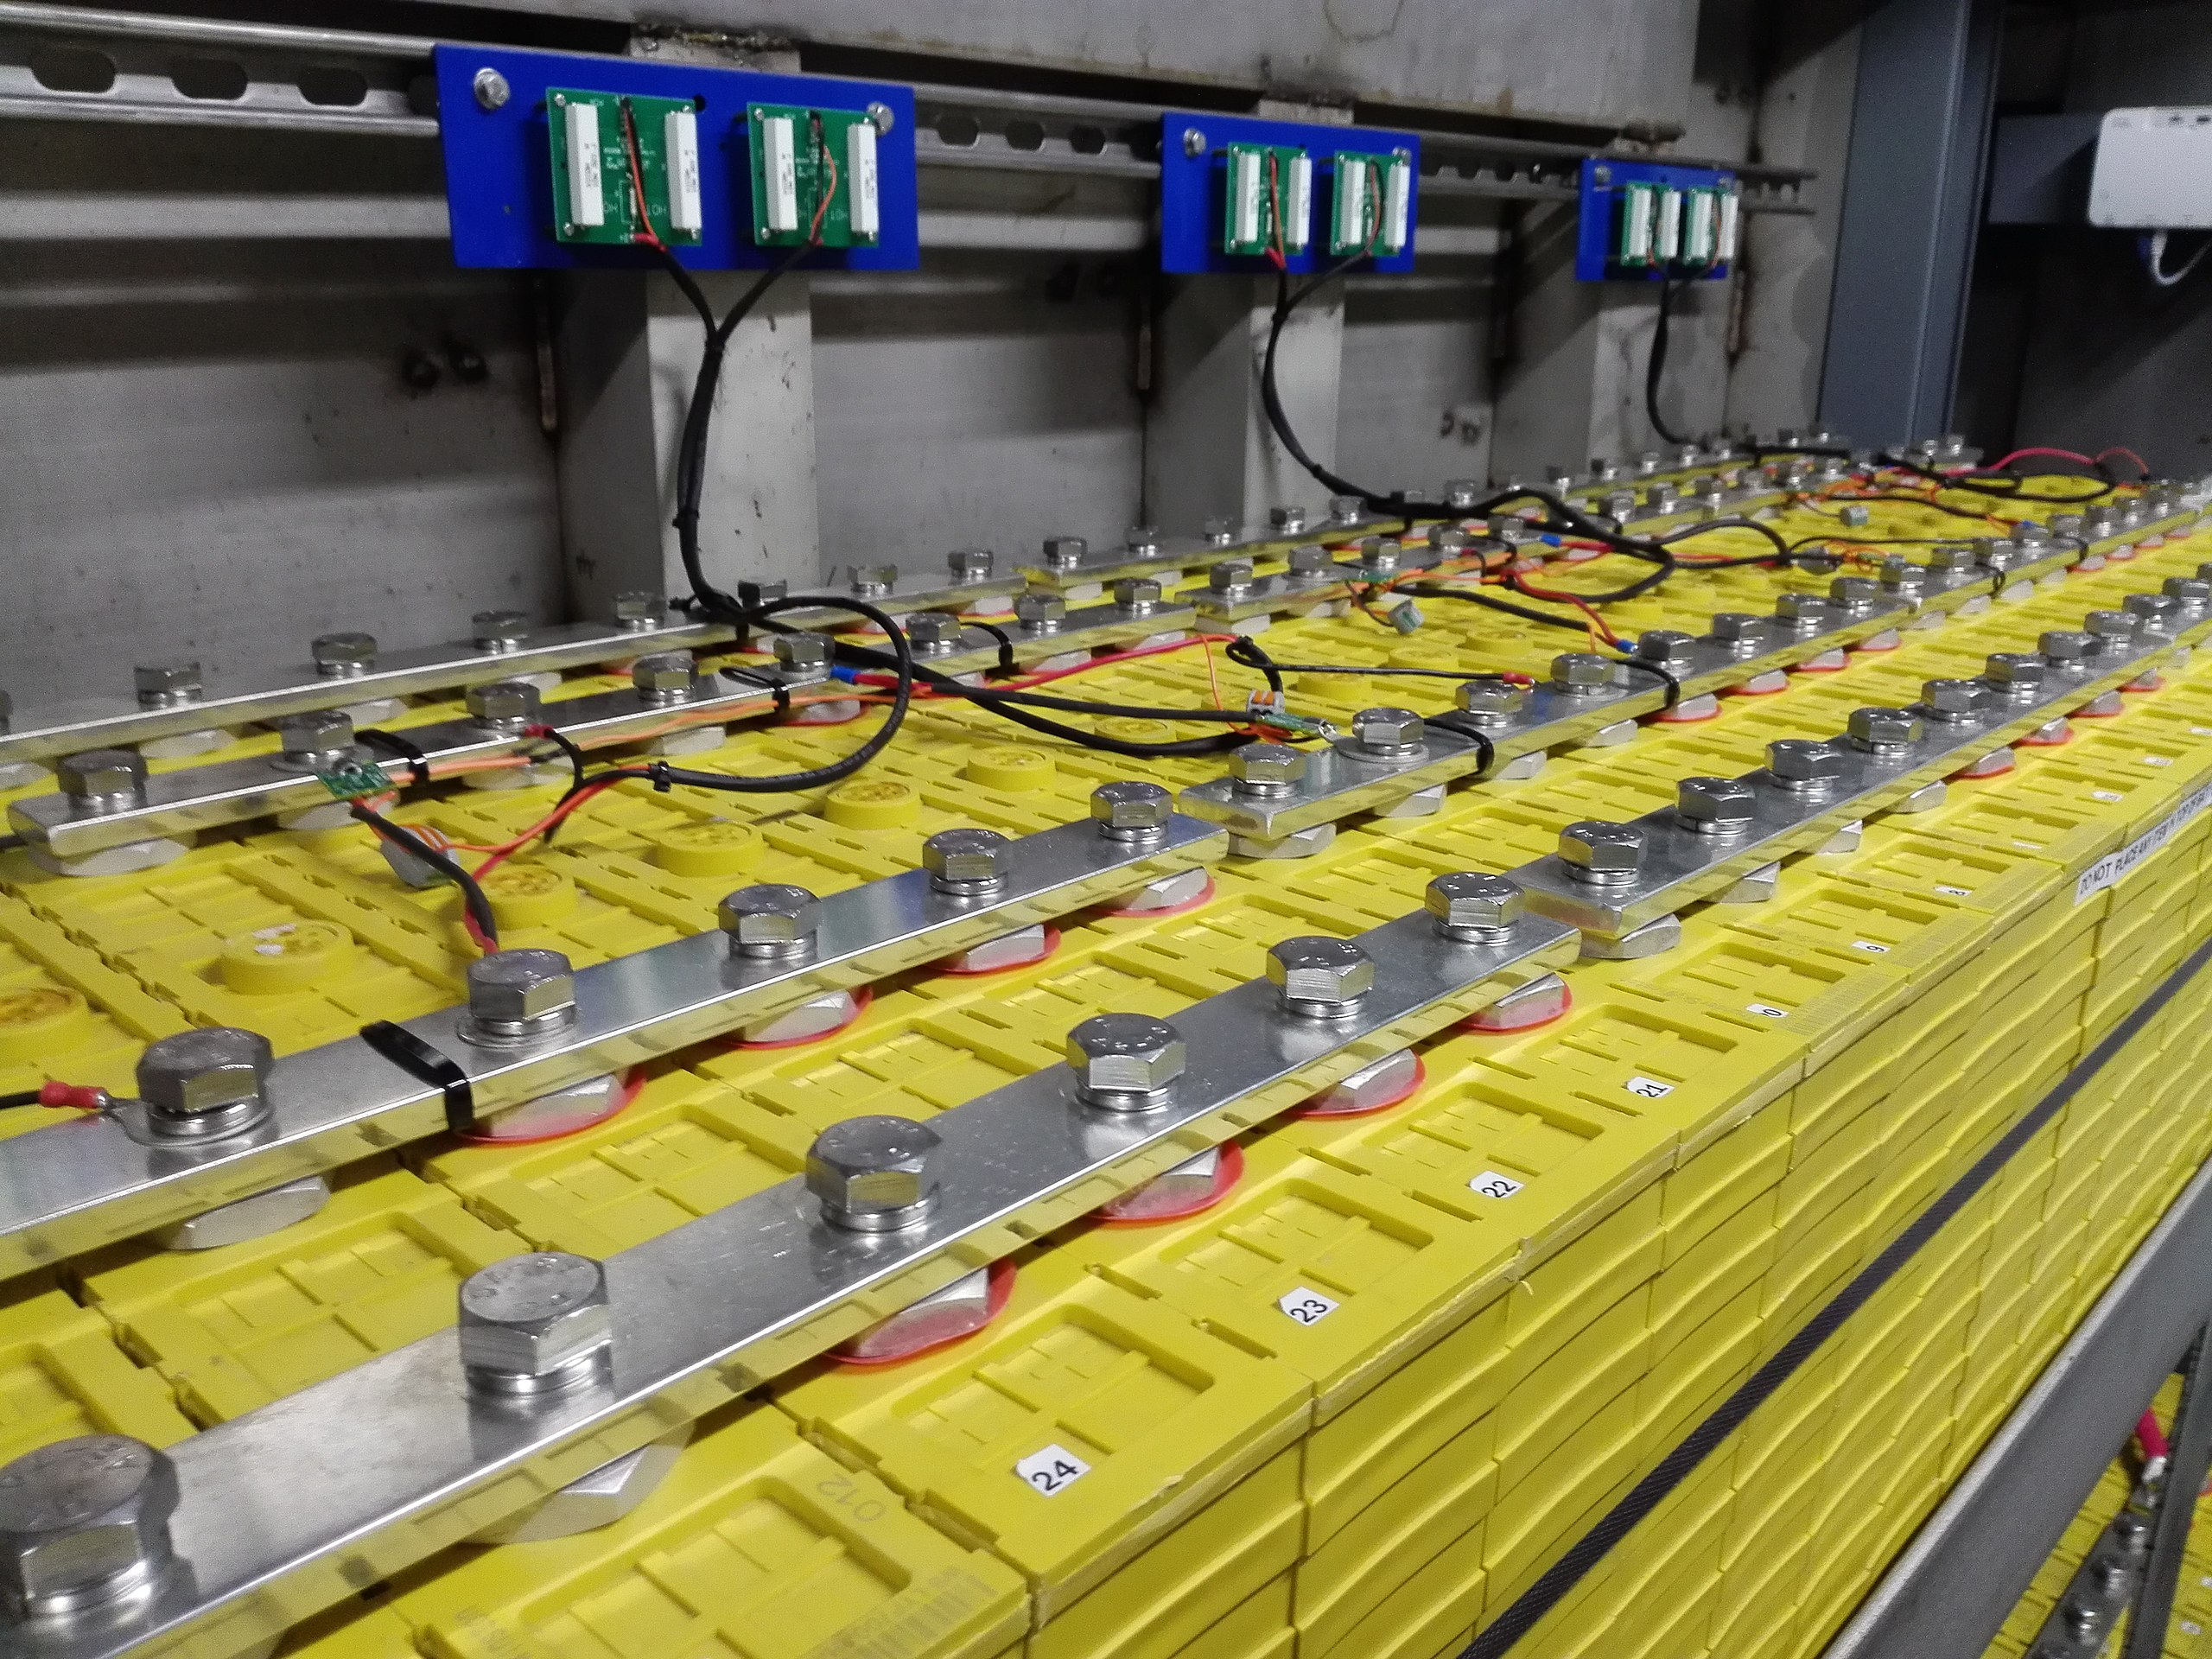
Alternative Sources of Energy
Power-to-X
1. Yo-Co-Man – https://upload.wikimedia.org/wikipedia/commons/0/08/Lithium_Iron_Phosphate_LiFePO4_Cells_700Ah_in_Parallel_and_Series_and_Busbar_-_1.jpg – CC BY-SA 4.0
2. Oeko-Institute e.V. – https://www.flickr.com/photos/oekoinstitut/48378513216 – CC BY-SA 2.0

Slide 17
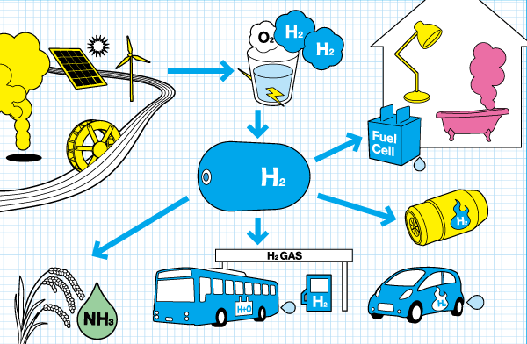
Alternative Sources of Energy
Green Hydrogen
Rh2netwrok – https://upload.wikimedia.org/wikipedia/commons/6/6f/RH2cycle.png – CC BY-SA 3.0

Slide 18
Electrification / Decarbonization

Slide 19
Electrification / Decarbonization
Electrify Everything (e.g. your home)
Rooftop solar panels
Home storage battery
Battery electric vehicles (bidirectional charging)
Electric cooking
Heat pump
Heating / cooling
Water heater
Dryer (clothes)
Etc.
Why? → Your home directly benefits (“more green”) from the general electric grid moving towards renewable energies.

Slide 20
Electrification / Decarbonization
Electrify Everything (e.g. your home)
Rooftop solar panels
Home storage battery
Battery electric vehicles (bidirectional charging)
Electric cooking
Heat pump
Heating / cooling
Water heater
Dryer (clothes)
Etc.
Why? → Your home directly benefits (“more green”) from the general electric grid moving towards renewable energies.

Slide 21
Electrification / Decarbonization
Electrify Everything (e.g. your home)
Rooftop solar panels
Home storage battery
Battery electric vehicles (bidirectional charging)
Electric cooking
Heat pump
Heating / cooling
Water heater
Dryer (clothes)
Etc.
Why? → Your home directly benefits (“more green”) from the general electric grid moving towards renewable energies.

Slide 22

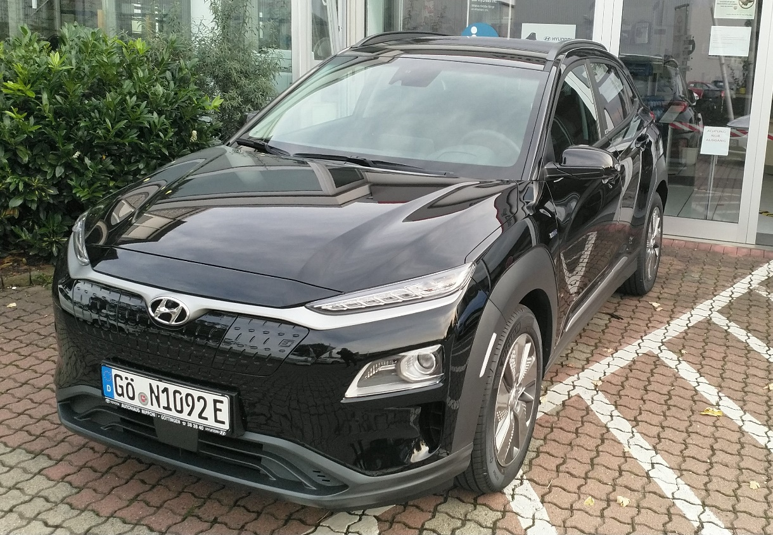
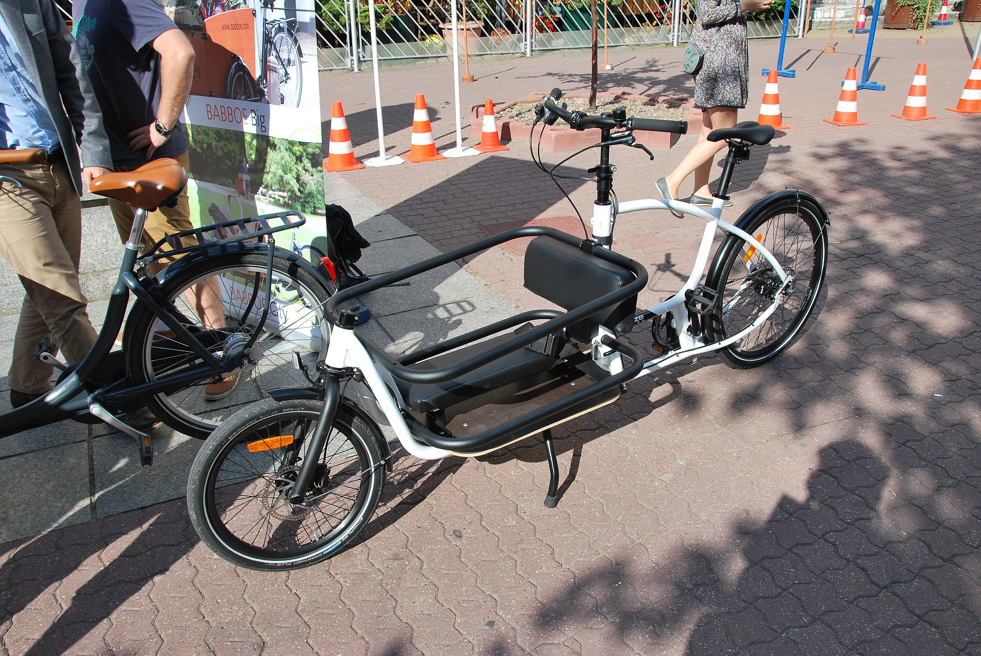
Electrification / Decarbonization
Alternative Forms of Transportation
1. Benjamin Leiding – CC BY-SA 4.0.
2. Fanny Schertzer – https://upload.wikimedia.org/wikipedia/commons/8/87/Hsc_fjord_cat_hirtshals.jpg – CC BY-SA 3.0
3. Zorro2212 – https://upload.wikimedia.org/wikipedia/commons/a/a0/European_Sustainable_Mobility_Week_in_%C5%81%C3%B3d%C5%BA_September_2015_09.jpg – CC BY-SA 4.0

Slide 23
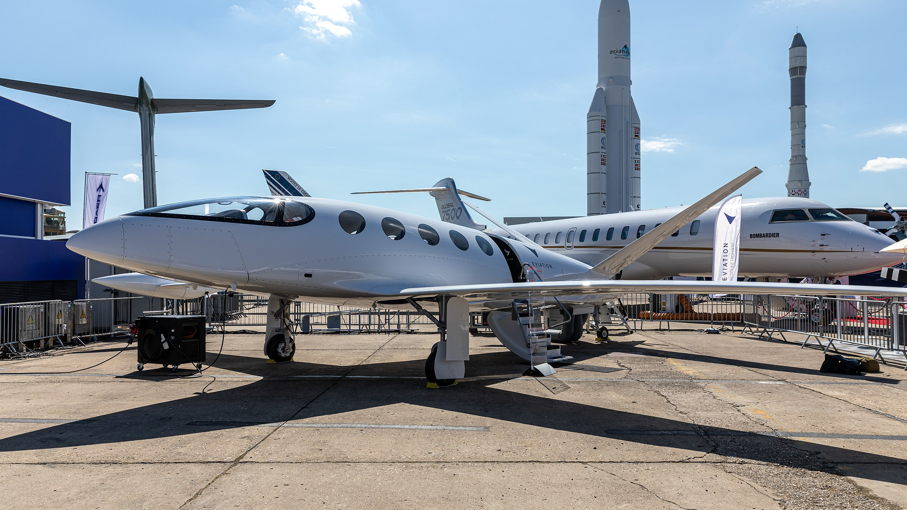
Electrification / Decarbonization
Alternative Forms of Transportation
Matti Blume – https://upload.wikimedia.org/wikipedia/commons/b/ba/Eviation_Alice%2C_Paris_Air_Show_2019%2C_Le_Bourget_%28SIAE8856%29.jpg – CC BY-SA 4.0

Slide 24


Electrification / Decarbonization
Alternative Forms of Transportation
1.Matti Blume – https://upload.wikimedia.org/wikipedia/commons/b/ba/Eviation_Alice%2C_Paris_Air_Show_2019%2C_Le_Bourget_%28SIAE8856%29.jpg – CC BY-SA 4.0
2.Benjamin Leiding – CC BY-SA 4.0.

Slide 25
Electrification / Decarbonization
Alternative Forms of Transportation
1.Matti Blume – https://upload.wikimedia.org/wikipedia/commons/b/ba/Eviation_Alice%2C_Paris_Air_Show_2019%2C_Le_Bourget_%28SIAE8856%29.jpg – CC BY-SA 4.0
2.Benjamin Leiding – CC BY-SA 4.0.

Slide 26
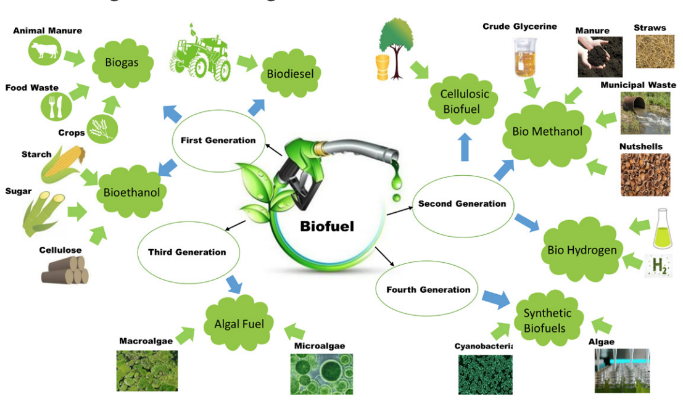
Electrification / Decarbonization
Biofuel
Muhammad Rizwan Javed, Muhammad Junaid Bilal, Muhammad Umer Farooq Ashraf, Aamir Waqar, Muhammad Aamer Mehmood, Maida Saeed and Naima Nashat. – https://upload.wikimedia.org/wikipedia/commons/d/d9/Types_and_generation_of_biofuels.png – CC BY-SA 4.0

Slide 27
Climate-resilient Food Production

Slide 28
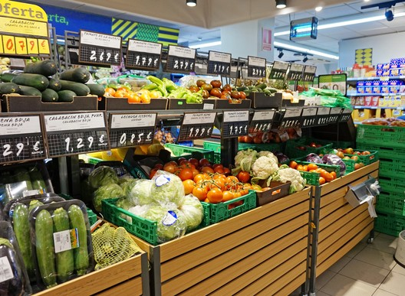
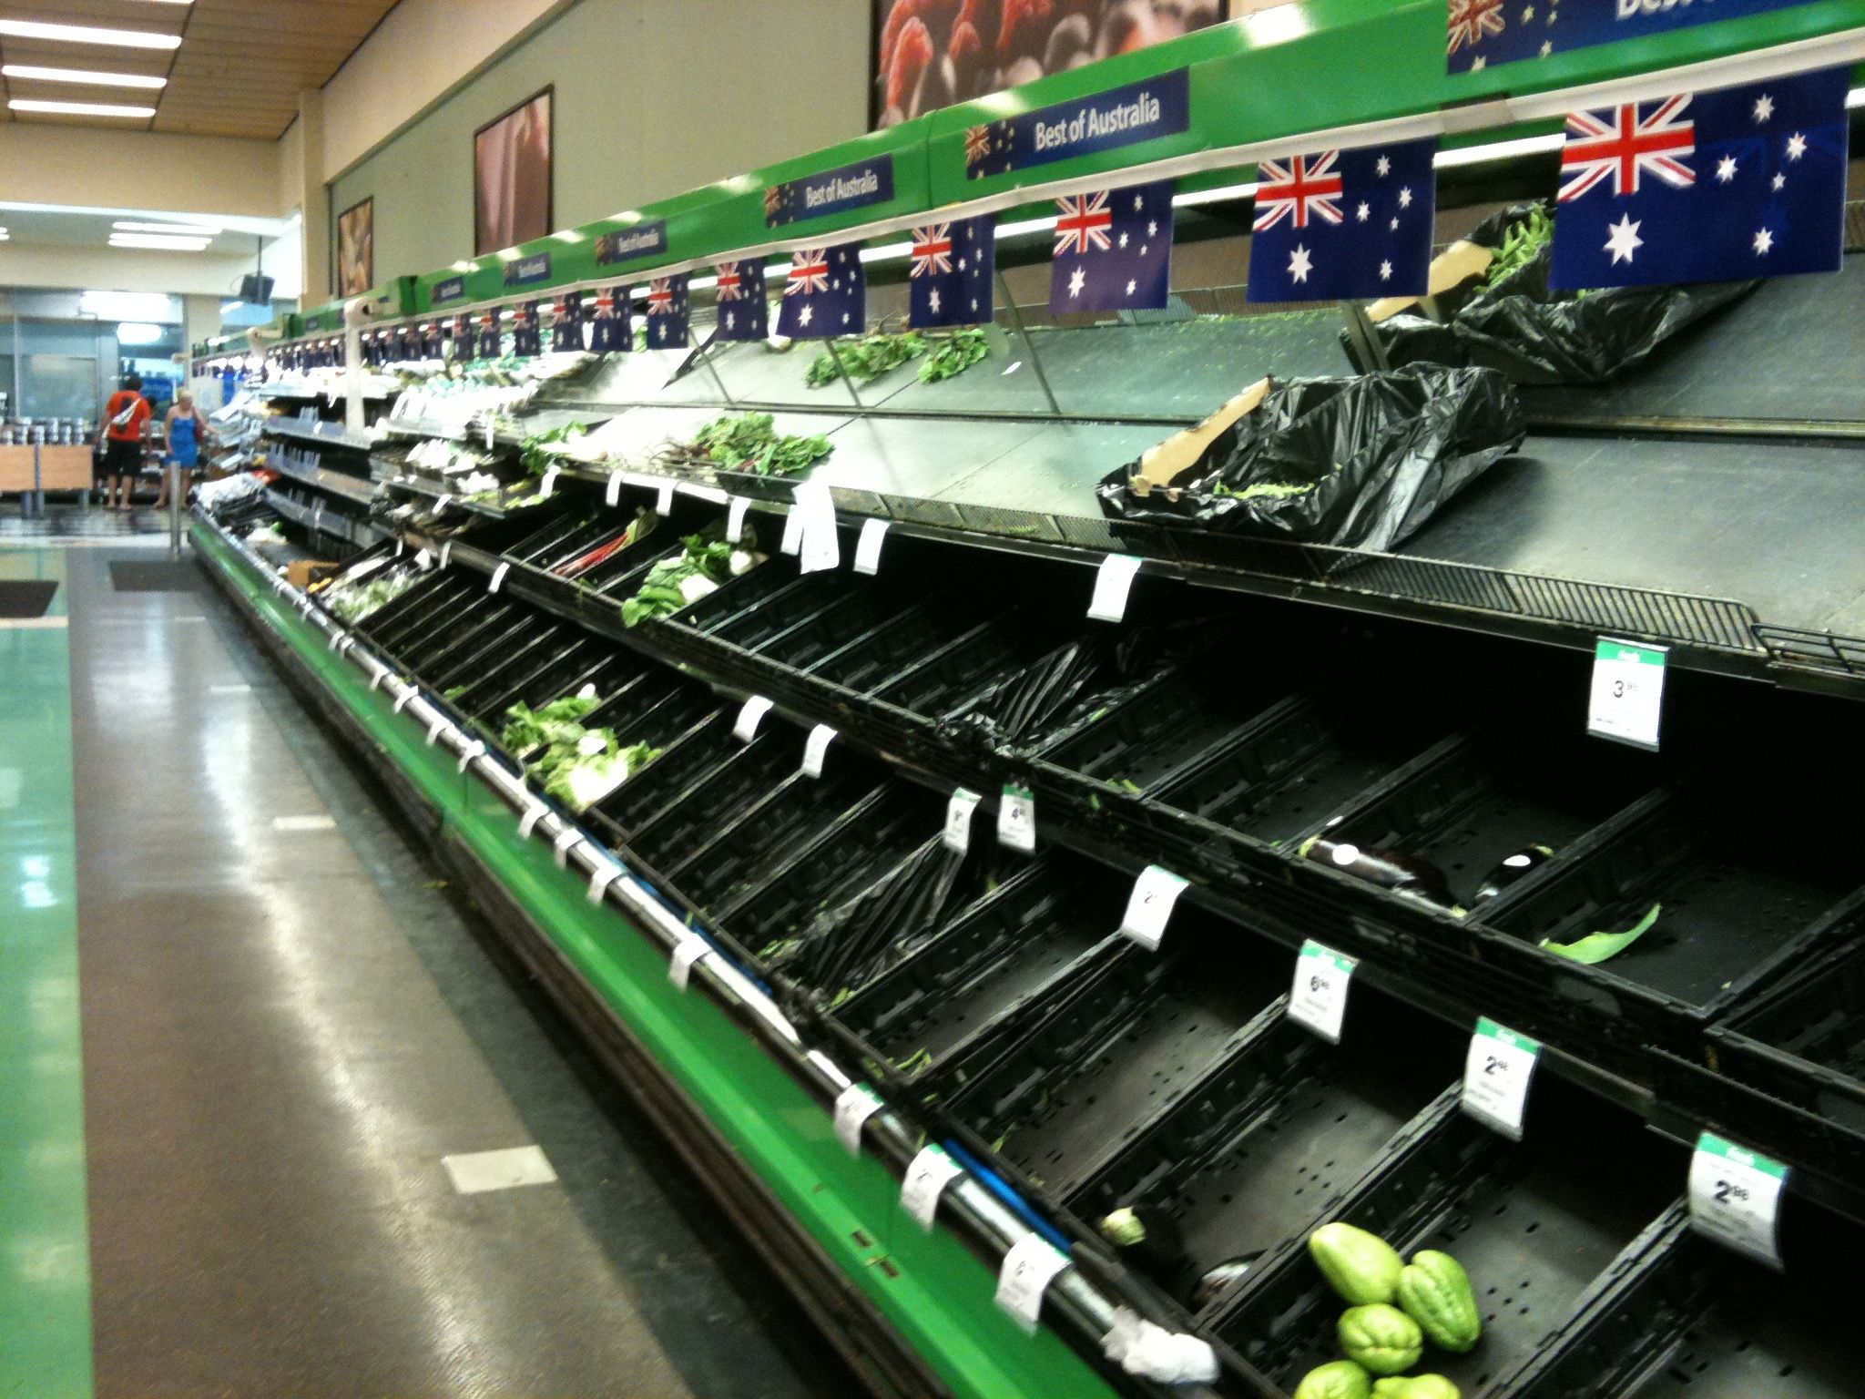
Climate-Resilient Food Production
Introduction
1. Tiia Monto – https://commons.wikimedia.org/wiki/File:Vegetables_in_supermarket.jpg – CC BY-SA 3.0.
2. Martin Shaw – https://commons.wikimedia.org/wiki/File:Vegetable_section_empty_in_a_supermarket_in_Kenmore.jpg – CC BY 2.0.

Slide 29
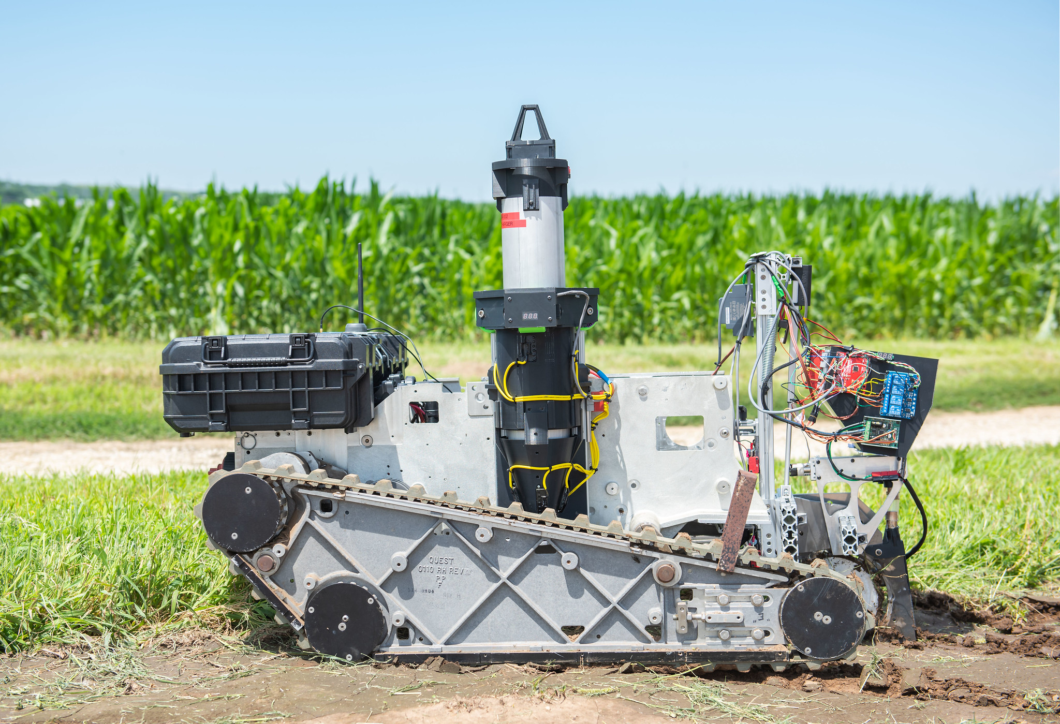
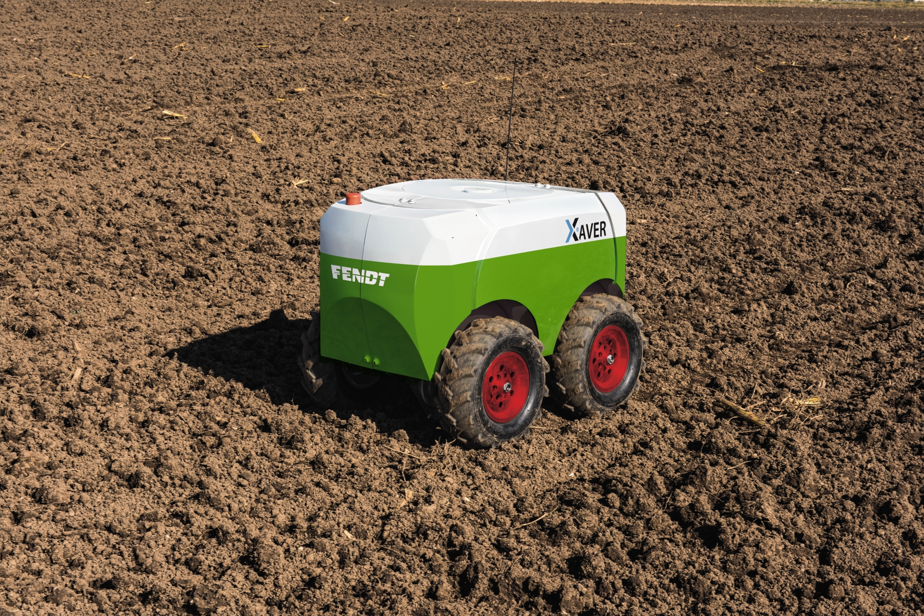
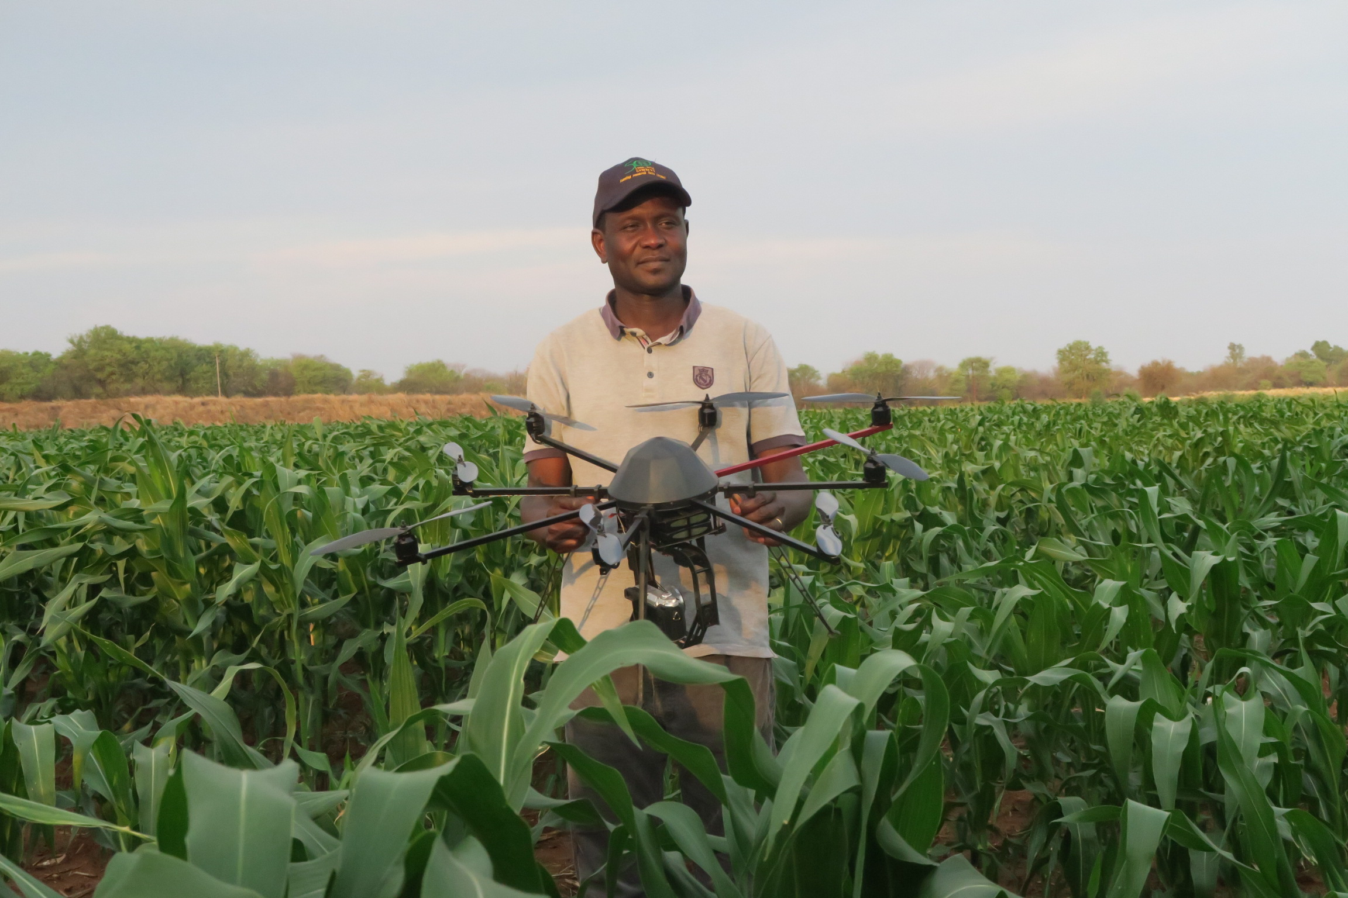
Climate-Resilient Food Production
Smart Farming
1. AGCO-Fendt – https://upload.wikimedia.org/wikipedia/commons/b/b3/Fendt_Xaver.jpg – CC BY-SA 4.0.
2. K-State Research and Extension – https://www.flickr.com/photos/ksrecomm/49090900066 – CC BY 2.0.
3. Climate Change, Agriculture and Food Security – https://www.flickr.com/photos/cgiarclimate/30947602551 – CC BY-NC-SA 2.0.

Slide 30
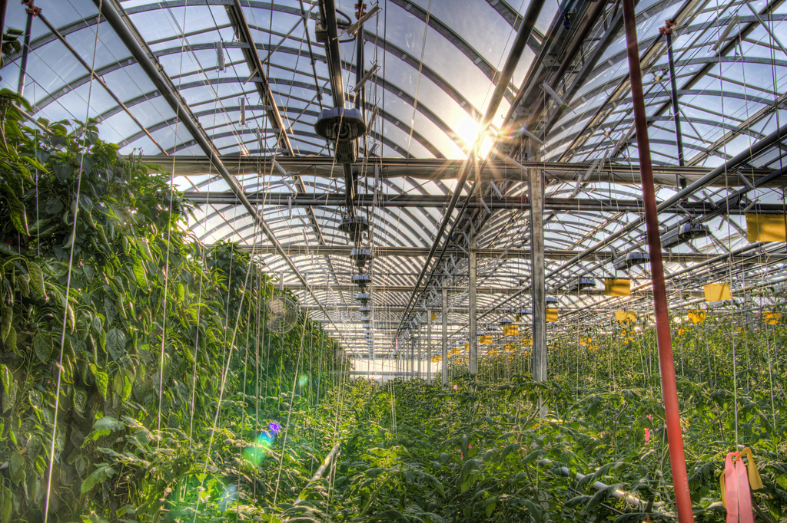
Climate-Resilient Food Production
Indoor Farming
Fadi Hage. – https://upload.wikimedia.org/wikipedia/commons/9/9f/Lufa_Farms_Montreal_rooftop_greenhouse.jpg – CC BY-SA 3.0

Slide 31
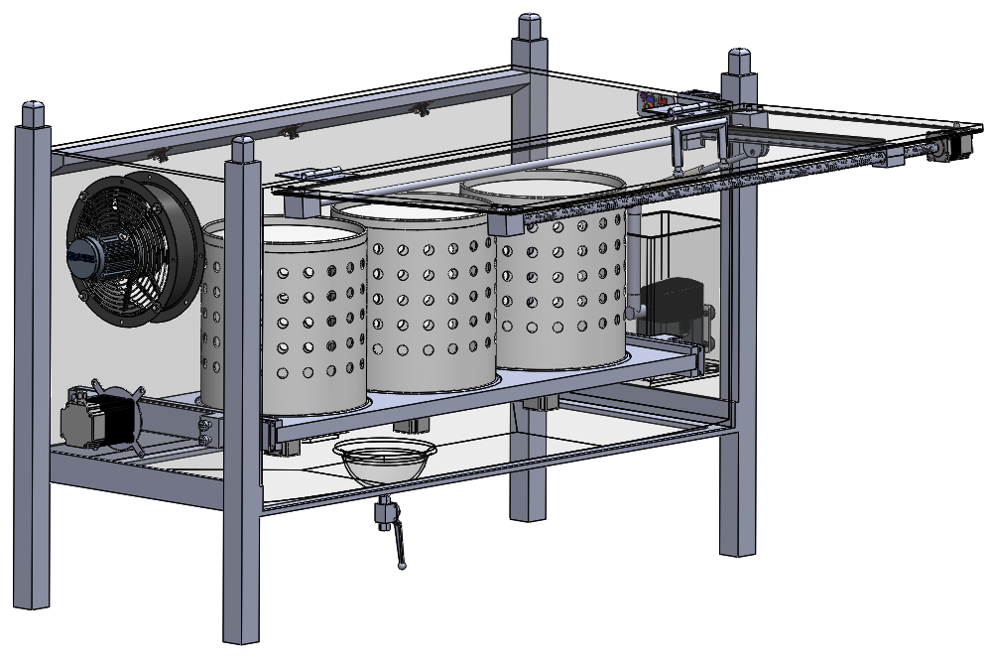
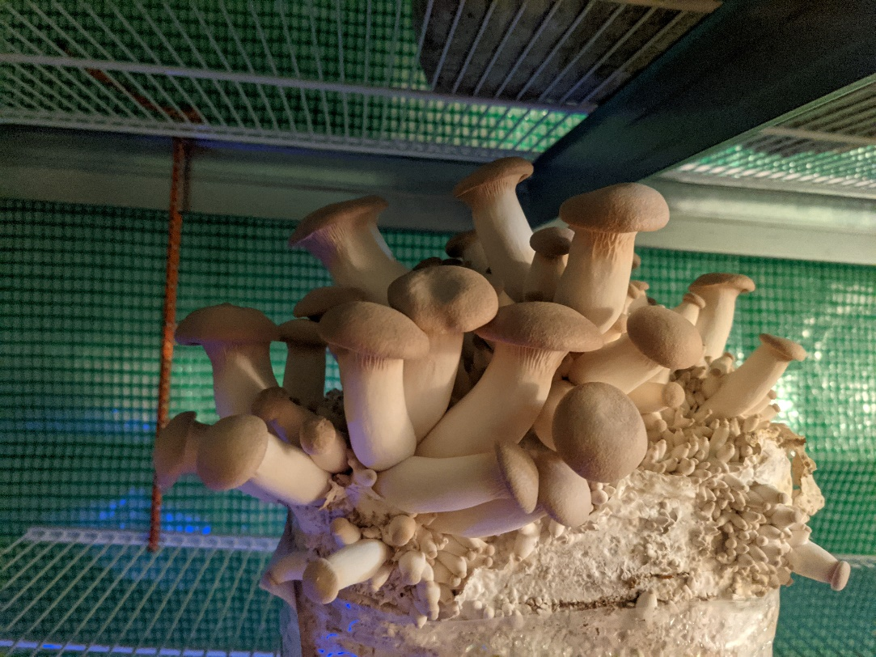
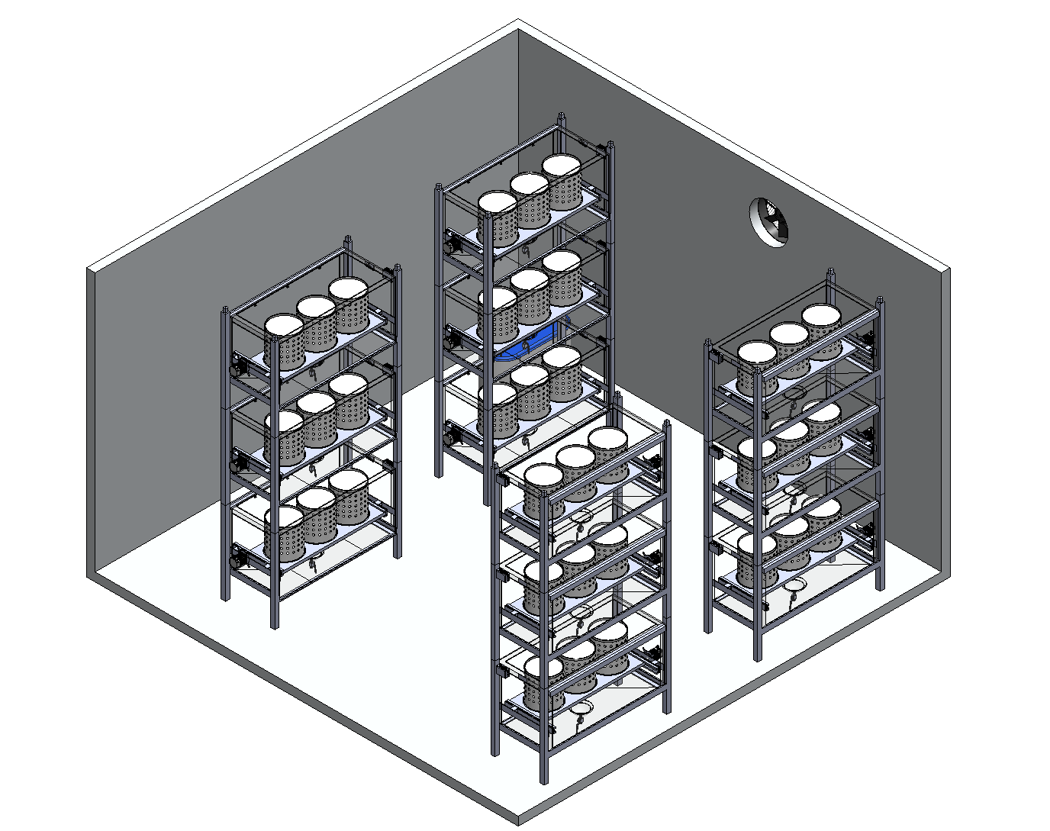
Climate-Resilient Food Production
Indoor Farming – Vegetables to Mushrooms
Benjamin Leiding – CC BY-SA 4.0
Dominique Briechle – CC BY-SA 4.0

Slide 32
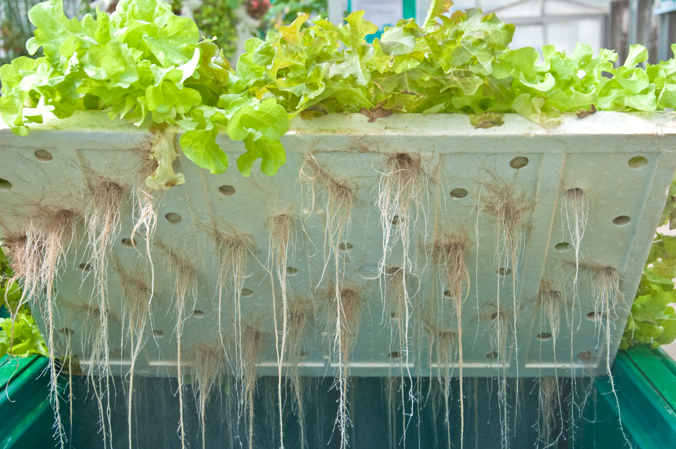
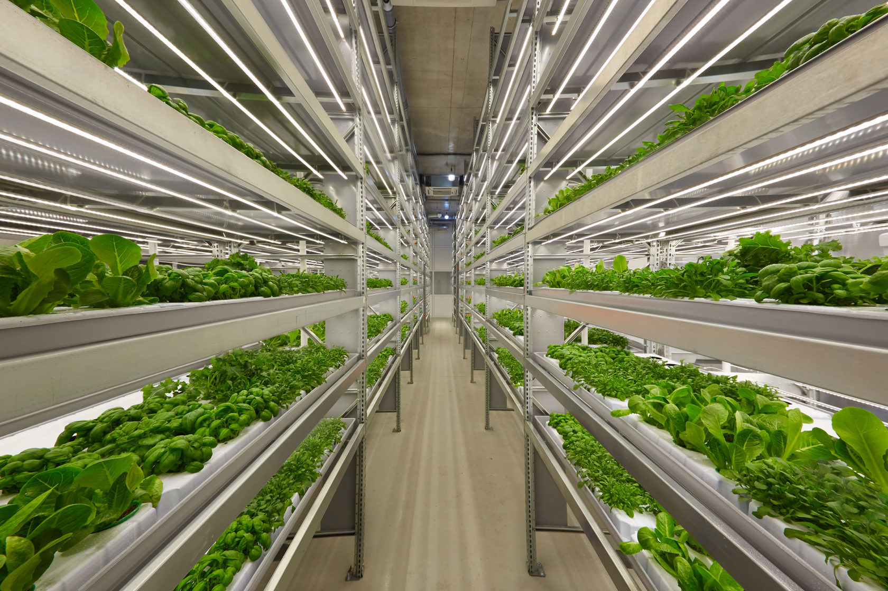
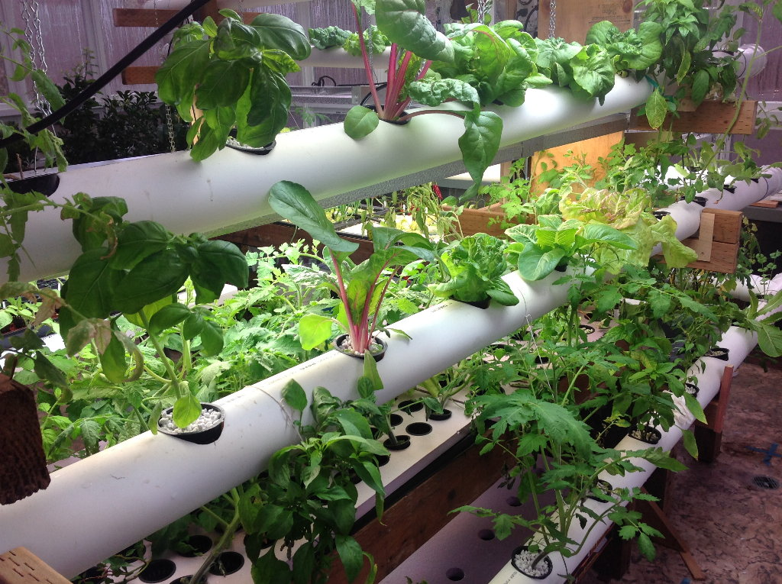
Climate-Resilient Food Production
Vertical Farming
1. ifarm.fi – https://upload.wikimedia.org/wikipedia/commons/5/5a/IFarm.fi_Vertical_farm_Finland.jpg – CC BY-SA 4.0.
2. ILRI – Aeroponics – https://www.flickr.com/photos/ilri/28664986336 – CC BY-NC-ND 2.0.
3. Aqua Mechanical – https://www.flickr.com/photos/aquamech-utah/24443777644 – CC BY 2.0
4. Oregon State University – https://upload.wikimedia.org/wikipedia/commons/3/36/Hydroponics_%2833185459271%29.jpg – CC BY-SA 2.0

Slide 33
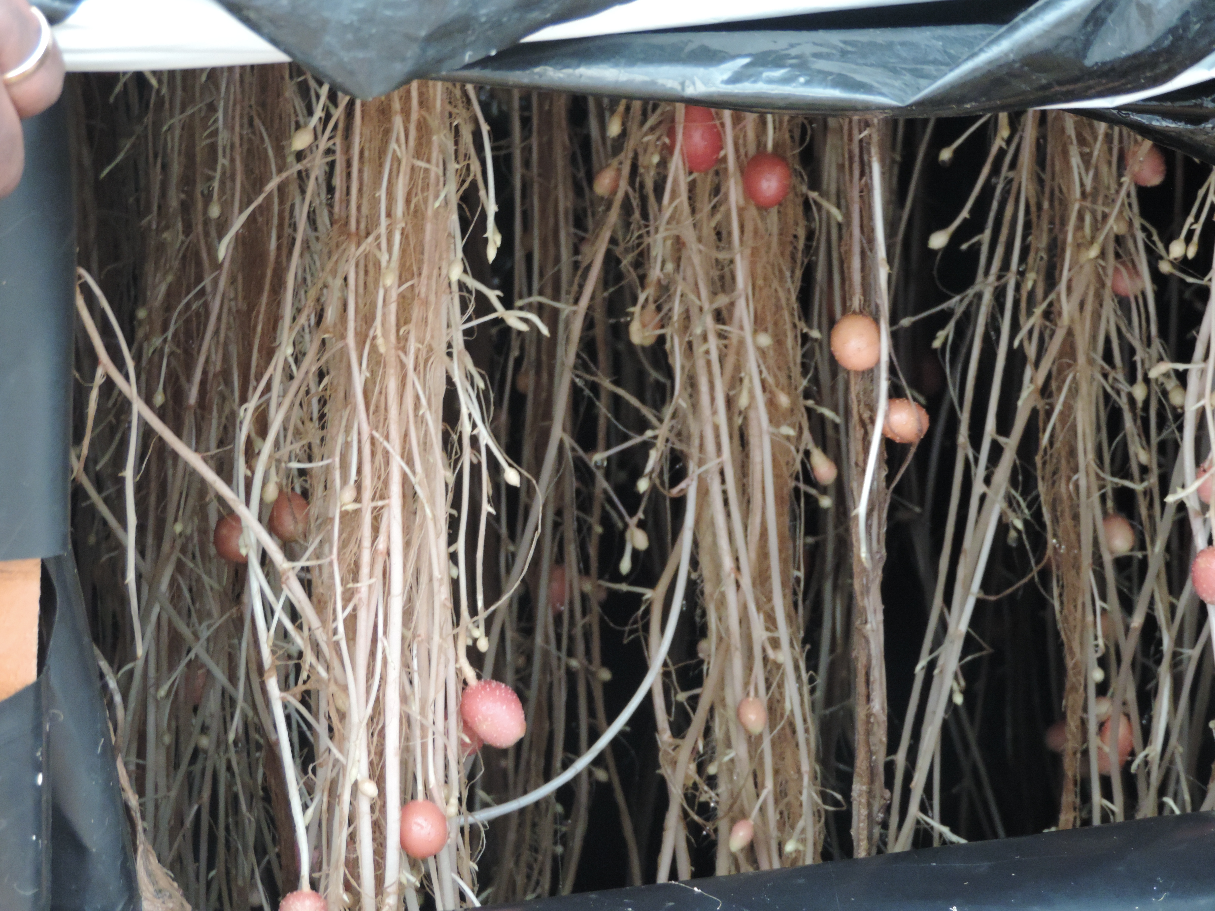
Climate-Resilient Food Production
Vertical Farming
1. ifarm.fi – https://upload.wikimedia.org/wikipedia/commons/5/5a/IFarm.fi_Vertical_farm_Finland.jpg – CC BY-SA 4.0.
2. ILRI – Aeroponics – https://www.flickr.com/photos/ilri/28664986336 – CC BY-NC-ND 2.0.
3. Aqua Mechanical – https://www.flickr.com/photos/aquamech-utah/24443777644 – CC BY 2.0
4. Oregon State University – https://upload.wikimedia.org/wikipedia/commons/3/36/Hydroponics_%2833185459271%29.jpg – CC BY-SA 2.0

Slide 34
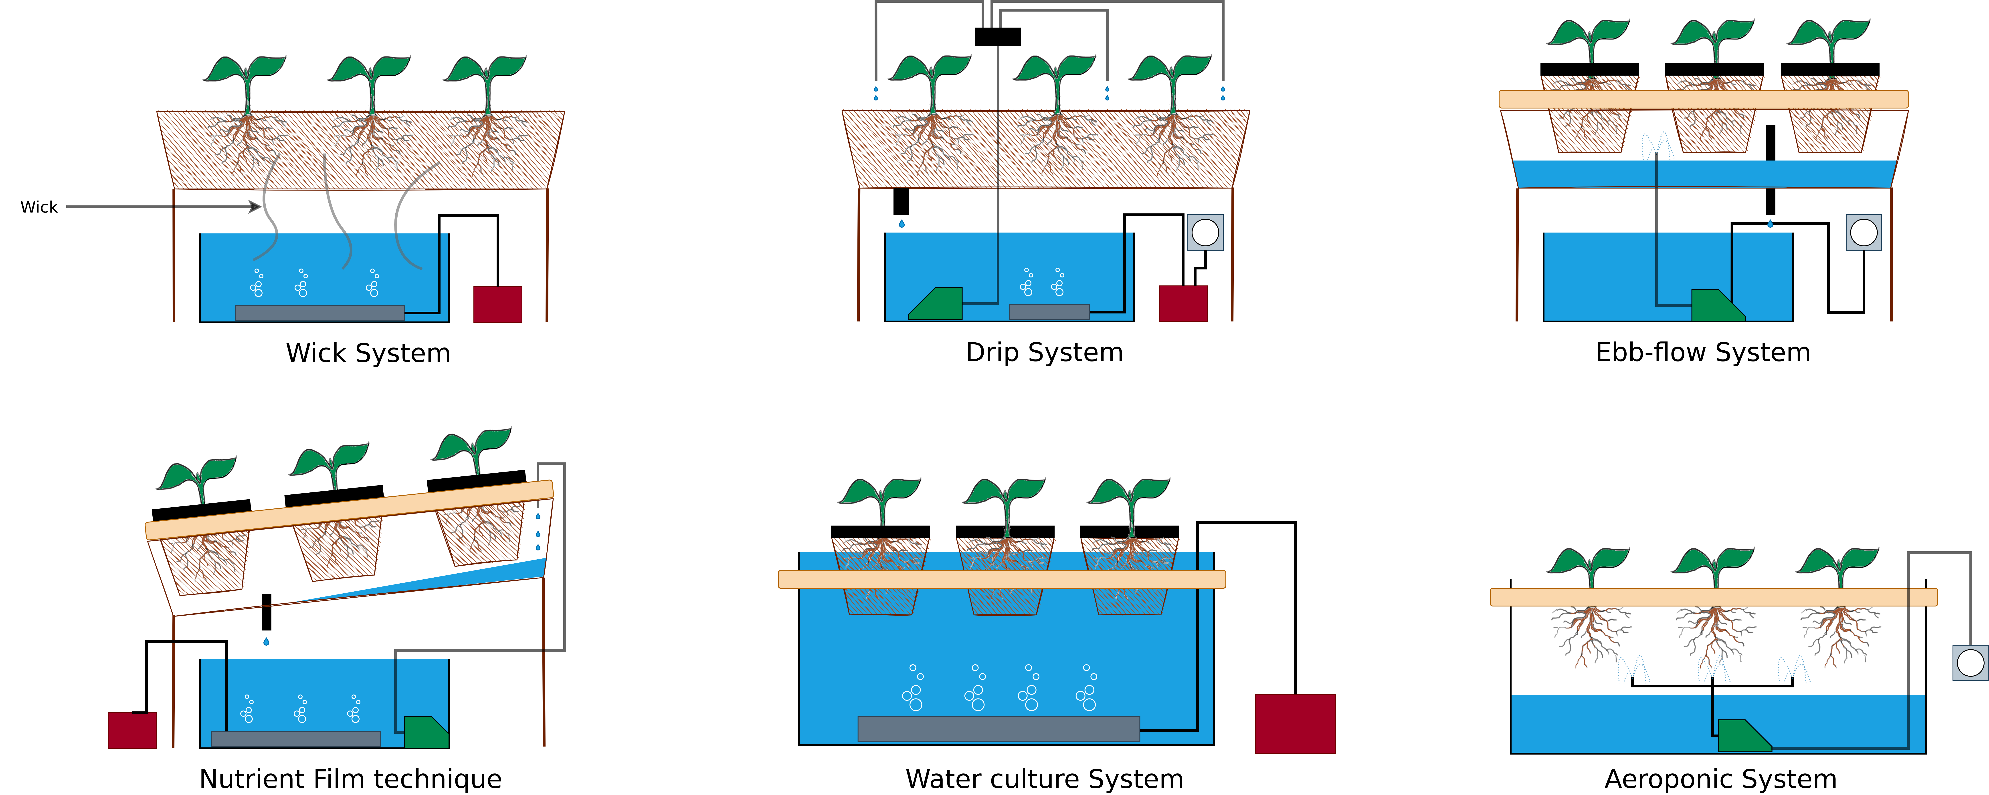
Climate-Resilient Food Production
Vertical Farming – Hydroponic Systems
Image adapted from: S. Lee, J. Lee (2015) – Beneficial bacteria and fungi in hydroponic systems: Types and characteristics of hydroponic food production methods – Link.
Plant graphic edited and adapted from original work titled “Gravel in Plant Container Causing Wet Soil Graphic” authored by “Garlan Miles” – Link.

Slide 35
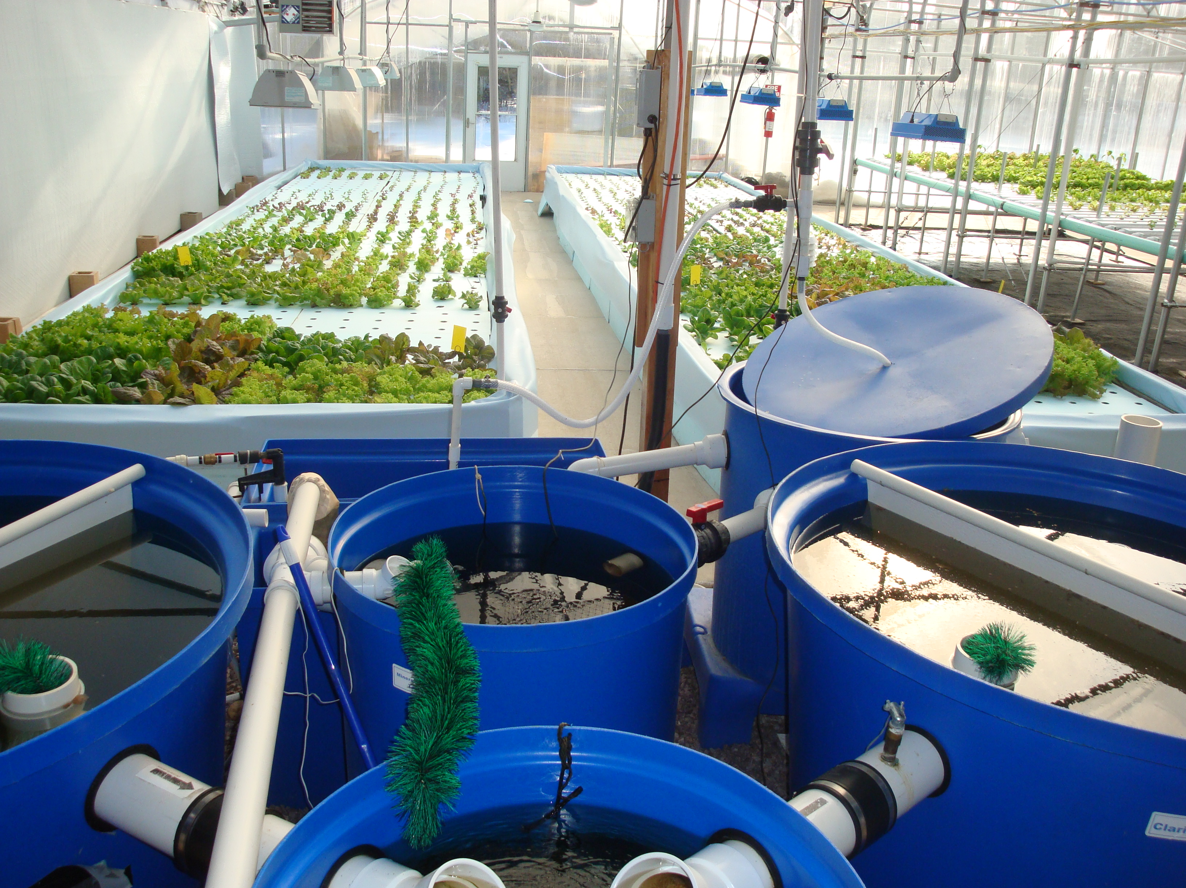
Climate-Resilient Food Production
Aquaponics
Kate Field – https://www.flickr.com/photos/gatewayhorticulture/6852357005 – CC BY-SA 2.0

Slide 36
Climate-Resilient Food Production
Aquaponics
Aquaponic spaceship on the Oker in Braunschweig → Link

Slide 37
Climate-Resilient Food Production
Aquaponics – What’s next?

Slide 38
Climate-Resilient Food Production
Aquaponics – What’s next?
Insects!

Slide 39
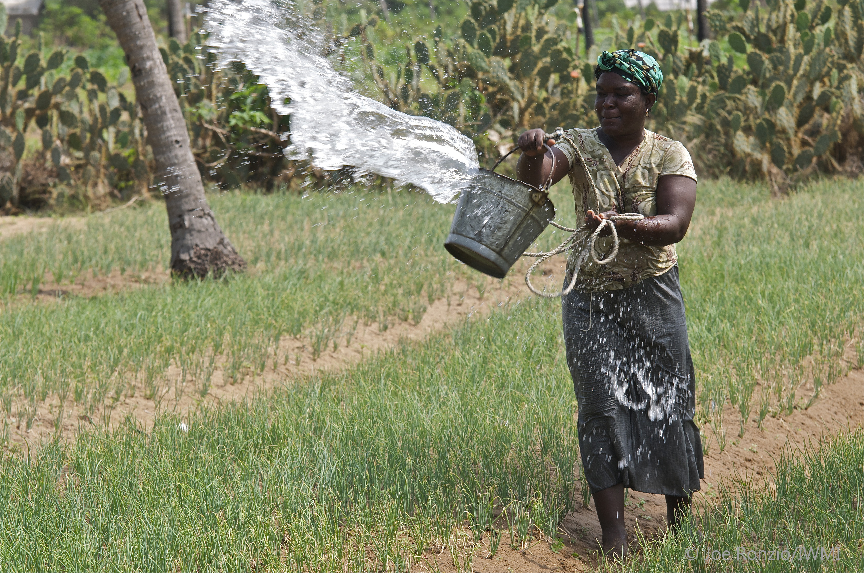
Climate-Resilient Food Production
Irrigation Management
IWMI Flickr Photos – https://www.flickr.com/photos/iwmi/8662458036 – CC BY-NC-ND 2.0

Slide 40
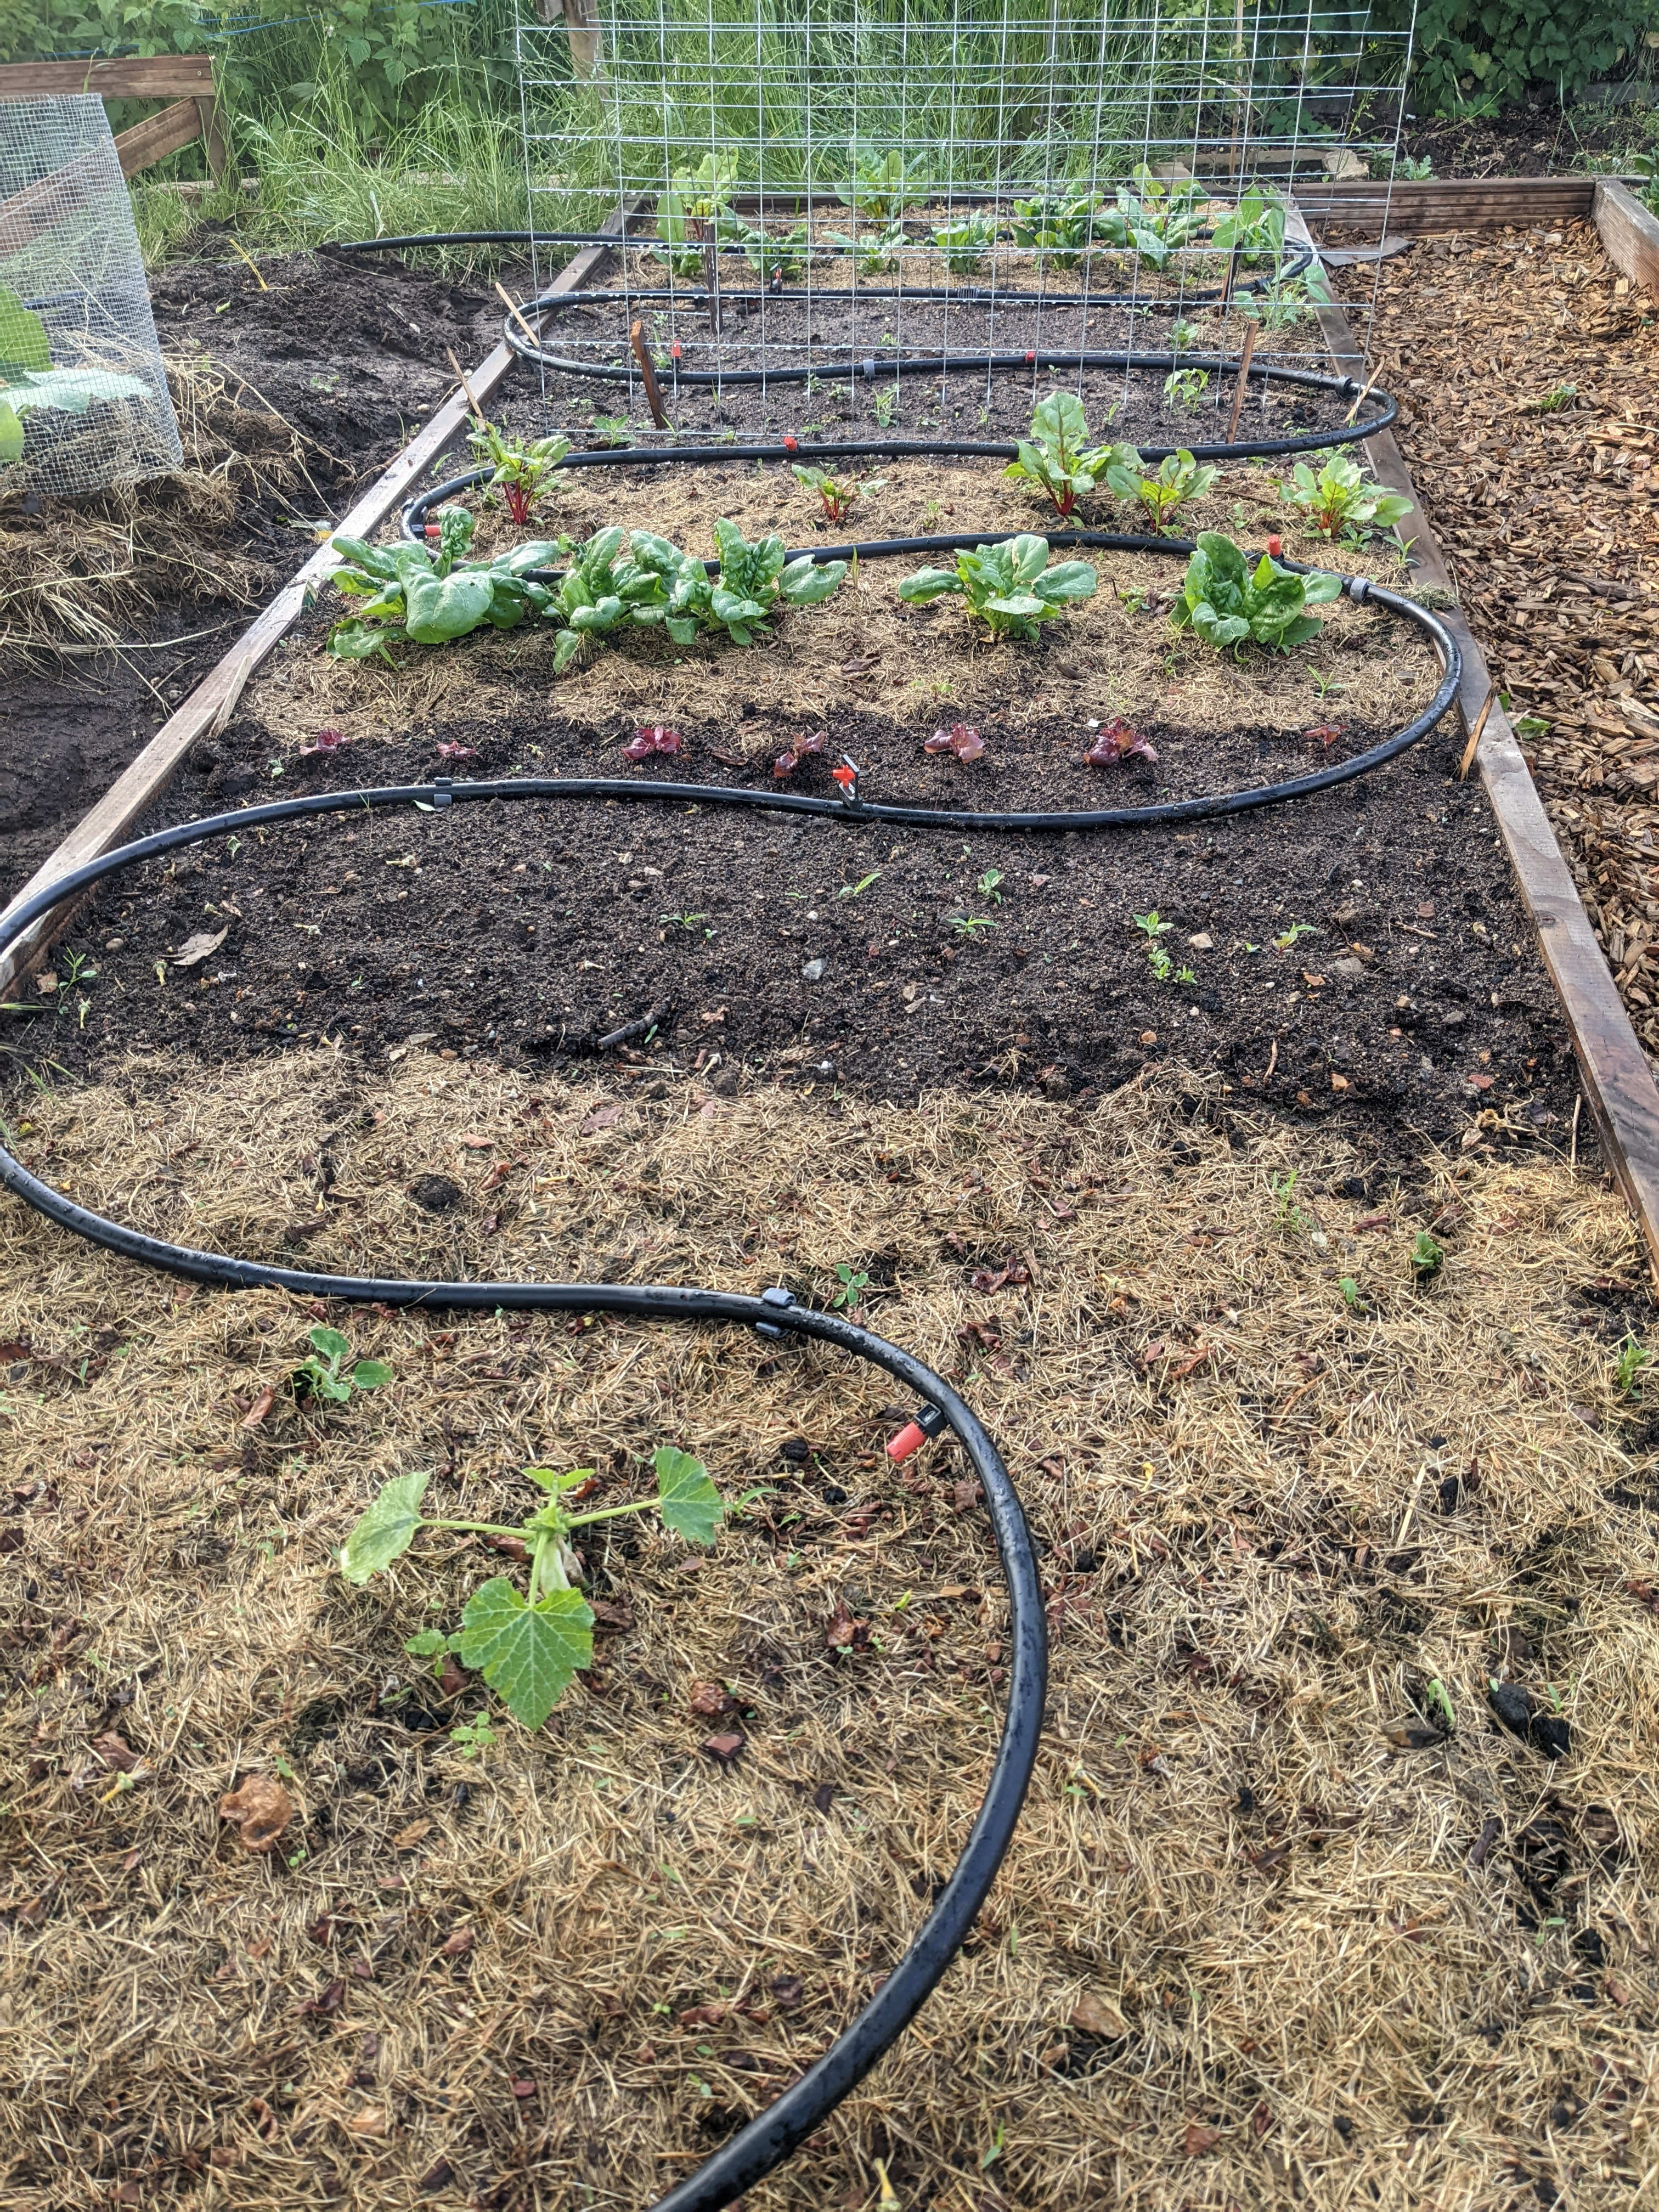
Climate-Resilient Food Production
Irrigation Management
1. IWMI Flickr Photos – https://www.flickr.com/photos/iwmi/8662458036 – CC BY-NC-ND 2.0
2. Benjamin Leiding – CC BY-SA 4.0

Slide 41
Climate-Resilient Food Production
Ecological (No/Low-Tech) Alternatives
Agroforestry → Trees/shrubs are grown around or among crops or pastureland (Link)
Permaculture → Growth of an agricultural ecosystem in a self-sufficient and sustainable way (Link)
Silvopasture → Trees, forage and domesticated animals in a mutually beneficial way
Etc.

Slide 42
OThers

Slide 43
Others
Overview
Green cement/steel/aluminum/...
Desalination
Water purification
Etc.

Slide 44
Conclusion

Slide 45
Conclusion
I am not saying that all sustainability-related technologies are bad!
→ However, business-as-usual in conjunction with sustainable technologies is not the solution, it is rather a supporting aspect
→ We are buying some time, that’s it
Most sustainability-related technologies are complex and require a lot of resources and energy
Also: Given a remaining set of resources and a remaining carbon budget → Which (emerging/sustainability-related) technologies can we afford to work on?

Slide 46
Exercise E08

Slide 47
Exercise E08
Technology Assessment
LAST EXERCISE!
Task:
Suppose a new sustainability-related technology is presented to you.
What are meaningful criteria to assess its contribution to a more sustainable world, i.e., how do you figure out whether it promotes greenwashing or not?
Submit your submission according to the instruction

Slide 48
Exercise E08
Technology Assessment
LAST EXERCISE!
Task:
Suppose a new sustainability-related technology is presented to you.
What are meaningful criteria to assess its contribution to a more sustainable world, i.e., how do you figure out whether it promotes greenwashing or not?
Submit your submission according to the instructions in the exercise sheet.

Slide 49
Additional Resources
How to Save a Planet – Electrify This! (Podcast) – Link
Food and Environment Reporting Network – Hot Farm (Podcast) – Link
D. Holmgren (2002). Permaculture: Principles & Pathways Beyond Sustainability
W. B. Arthuer (2011). The Nature of Technology – What It Is and How It Evolves

Slide 50
Questions?

